Slide 1
Life Sciences at a Distance
Giving Students Hands-on Experiences Even When You Can’t Shake Their Hands

Slide 2
Challenges of Life Sciences in DE
Life Sciences classes often have hands-on / experiential components
Access to specialized equipment & materials
Microscopes
Animal carcasses
Learning specific skills
How to mix chemicals
Silver lining: Sometimes online labs are better…
Notes:
When we work with instructors who are solving the problem of teaching a lab to Distance Education students, we always start the same way. We ask them what they really need their students to learn. This leads to a process of creating online activities that accomplish the objectives rather than a process of just replicating the lab. And in many cases we find that there are benefits to the DE activities that balance out the equation.
As you will see, for some labs, video demonstrations are the answer, for some interactive HTML and Flash elements work, and for others hands-on work is still the answer.
Taxonomy of lab activities?
- Demonstrations
- Teaching skills
Generally, labs involve haptic learning…

Slide 3
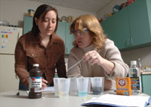
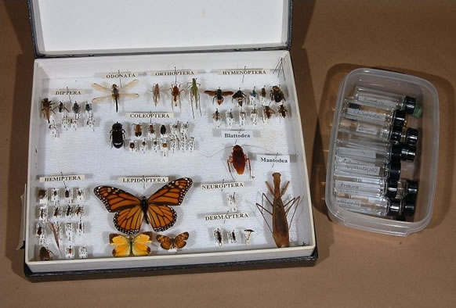
Send the “Hands-On” to Them!
Biology in a Box
Kitchen experiments
Take pictures
Communicate with TA
Insect Collection
Collect anywhere
Let dispersed students be a benefit!
Notes:
Along with the written course pack, students receive a cardboard box stuffed with the tools they'll need to conduct experiments at home
graduated cylinders
safety goggles
pH paper
Petri dishes
seeds
and more…
Students then provide household items
aluminum foil
rubbing alcohol
potting soil
vinegar
etc.
These kits enable students to conduct experiments very similar to those taking place in labs on campus, only they'll use kitchen sinks, stoves, microwaves and blenders instead.
As students complete each lab, they attach photographs of their experiments to the lab units and mail the packets to campus. Jim Mickle (instructor) , lab supervisors and TAs also correspond regularly with the students by e-mail and phone.
John Meyer has students create an insect collection, just as they would on campus. We’ll see more about this in a minute.
Both of these instructors, and others, take advantage of the fact that their students are *not* all in one place. The students see more diversity of insects (in one case) and ecology (in the other) than they would if they’re all on campus.

Slide 4
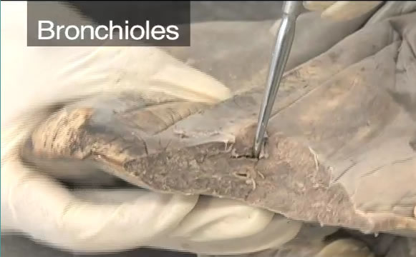
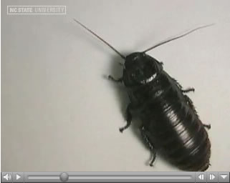
Video Does Wonders
Skill Teaching
How & Where to Collect
Expert Dissection > Quiz
Option to order carcass
Time-lapse Process
Animation can be like Video
Demonstration
“I can show things in the video that I was never able to show students before. The combination of close-up views and the ability to slow the motion of the insects really helps me teach this concept!”
Notes:
When the lab is a demonstration, a video capture of the event can be very effective. For instance, as part of the insect collection project, Dr. Meyer takes his students on field trips where they learn to collect insects in various environments.
A benefit of this approach is seeing an expert at work. For this Animal Science anatomy class, we captured the instructor and a TA doing some dissections and talking about what they were seeing as they were doing it.
We worked with Dr. David Shew on his plant pathology course for several years. Early on he identified several key concepts in his course that students struggled to understand. One was Koch’s Postulate which was demonstrated by a series of videos taken over the entire process. Another was the Gene for Gene concept. The solution was a Flash animation.
The silver lining to video is obviously the ability to watch it again and again. This is helpful in both the skill demo and the expert dissection. But another benefit is the ability to do things that you can’t do live. The anatomy video quiz is one example. Another is this one, of tripod walking. I really like this quote from the instructor.

Slide 5
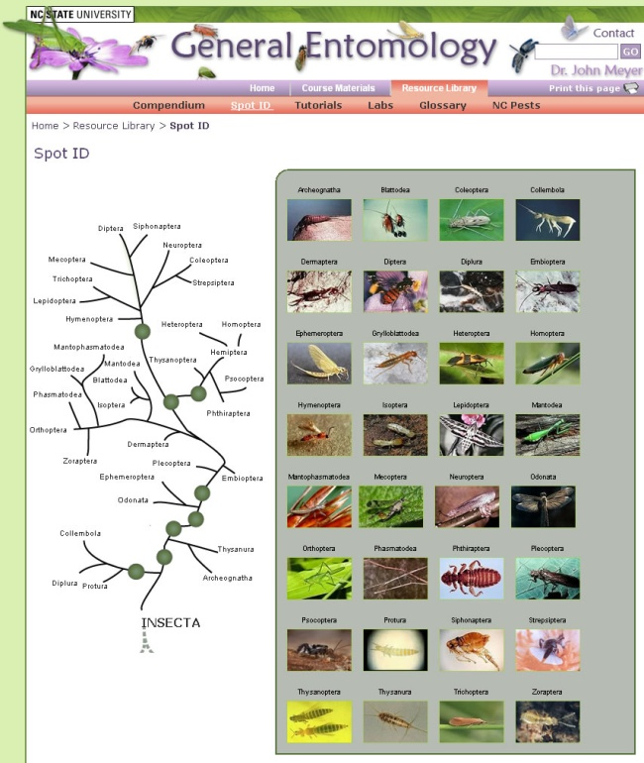
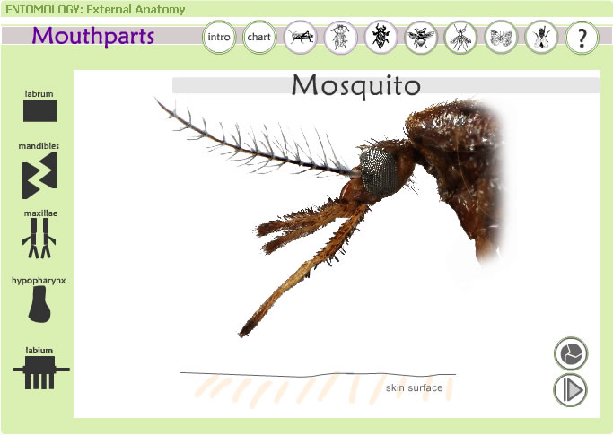
Hands-On means Interaction, right?
Online Spot ID Tool
External Anatomy Identification
Explore Mouthparts
Student POV
Not interactive, per se, but first-person view of interaction
Notes:
Later, understanding the diagnosis process was a challenge for his online lab. The solution involved the production team working closely with Dr. Shew over two years to develop a Flash-based game to simulate the diagnostic process for a diseased tomato plant.

Slide 6
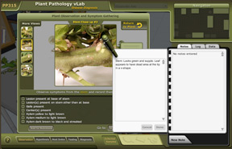
“Virtually” Perfect
Interactive Dissection Software
Virtual Lab
Notes:
ANS 206 is a lab course that explores major anatomical and cellular structures of domestic animals through examination of gross and microscopic anatomy. You already saw video dissections and quizzes. But there was also another way to get students to learn about the anatomical systems – exploration. In a regular lab, you might have students do their own dissections – and the question is why? In order to teach them *how* to dissect an animal? Or as another way to introduce them to anatomy and physiological systems? For this course it was the second of those.
We researched existing solutions and recommended virtual dissection software. Froguts is well-known and well-reviewed. And it happens to be incredibly cheap! $300 for a campus license for a year! Let’s look at a demo – I’ve gone ahead and fast-forwarded to the dissection part. Although this is a frog, they also have a foetal pig and a cow eye among other things. These were two specific things that Shannon had her students dissecting. And as I mentioned earlier, we provide information to students about how they can order their own specimens if they want to do their own real dissecting.

Slide 7
Questions?
Dr. Tom Miller Vice Provost for Distance Education & Learning Technologies
David Howard Associate Director, Instructional Design & Course Production
DELTA http://delta.ncsu.edu/

